Slide 1
Data Structure & Algorithms
Presented by:
DEBENDU KUMAR

Slide 2
I
Data Structures & Algorithms
Data structures is a method of organizing data in a virtual system. Think of sequences of numbers of tables of data, these both are well-defined data structures.
An algorithm is a sequence of steps executed by a computer that takes an input and transform it into a target output.

Slide 3
Types of Data Structures
Data Structures
Linear
Non-Linear
Array
Linked List
Stack
Queue
Graph
Tree
Notes:
Democratisation (means making something accessible and available to a wider range of people) and decentralisation (refers to distribution of power to authority away from a central authority or governing body to a local or regional authorities or communities)
Inclusivity and access for sellers especially small and medium enterprise as well as local businesses

Slide 4
Analysis of Algorithms
An algorithm is a set of instruction to perform a task or to sole a given problem
There are several different algorithms to solve a given problem
Analysis of algorithm deals in finding best algorithm which runs fast and takes in less memory
To determine the efficiently of algorithm we check
Time complexity
Space complexity
public Integer findSum(Integer n) { int sum = 0; for(int i = 1; i <= n; i++) { sum = sum + i; } return sum; }
public Integer findSum(Integer n) { return n * (n + 1) / 2; }
Notes:
network grievance – refers to a situation where a participant in the network experiences an issues or dispute related to the functioning of the network. To address network grievances blockchain communities often establish governance framework or dispute resolution mechanisms, such as voting systems or arbitration protocols, to help participants resolve issues and reach consensus on important decisions affecting the network.

Slide 5
Time Complexity
The amount of time taken by algorithm to run
The input processes by an algorithm helps in determining the time complexity

Slide 6
Space Complexity
The amount of memory or space taken by the algorithm to run
The memory required to process the input by an algorithm helps in determining the space complexity

Slide 7
Asymptotic Analysis
Asymptotic analysis of an algorithm refers to defining the mathematical foundation of its run-time performance. Using the asymptotic analysis, we can very well conclude the best case, average case and worst case scenario of an algorithm.
Using asymptotic analysis we don’t measure actual running time of algorithm.
It helps in determining how time and space taken by algorithm increases with input size

Slide 8
Asymptotic Notations
Asymptotic notations are the mathematical tools used to describe the running time of an algorithm in terms of input size .
Asymptotic notations help us in determining
Best case – Omega Ω, lower bound of algorithm’s running time, i.e best amount of time an algorithm can take to complete
Average case – Big O,
Worst case – Theta Θ

Slide 9
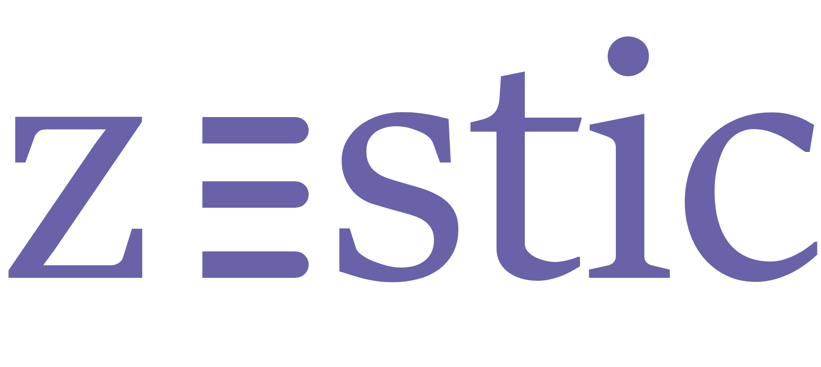
Thank you
www.zestic.in
Contact us: www.zestic.in/contact-us
All information present here is the exclusive property of Zestic IT Solutions (Zestic) and is subject to change without notice. Any unauthorized use of the content appearing here may violate copyright, trademark and other applicable laws.

